Slide 1

A Novel Safe Merging Algorithm for Connected Vehicles Using NetLogo

Slide 2

IMPLEMENTED ALGORITHMS:
Vehicle tracking algorithm
Merging control algorithm

Slide 3

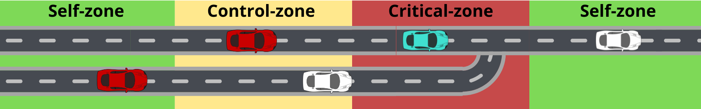
IMPLEMENTED ALGORITHMS:
Vehicle tracking algorithm
Merging control algorithm

Slide 4

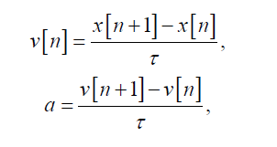
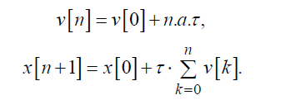
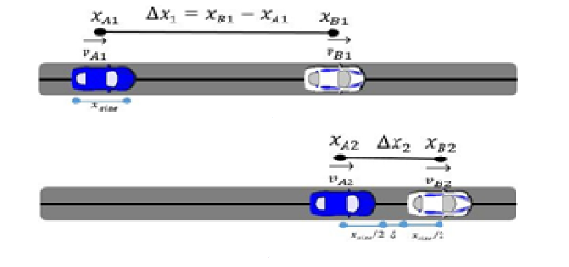


Vehicle tracking algorithm (1)
Inserisci qualche parola per dare un filo logico alle equazioni

Slide 5

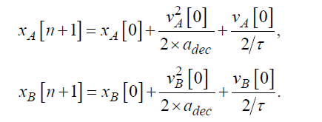
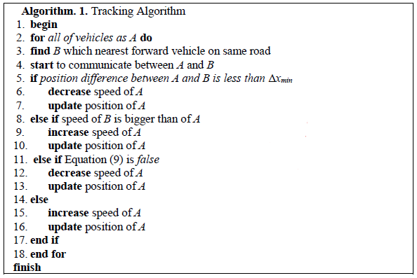
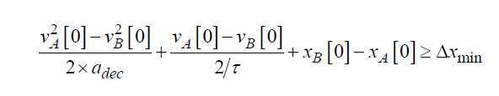
Vehicle tracking algorithm (2)

Slide 6
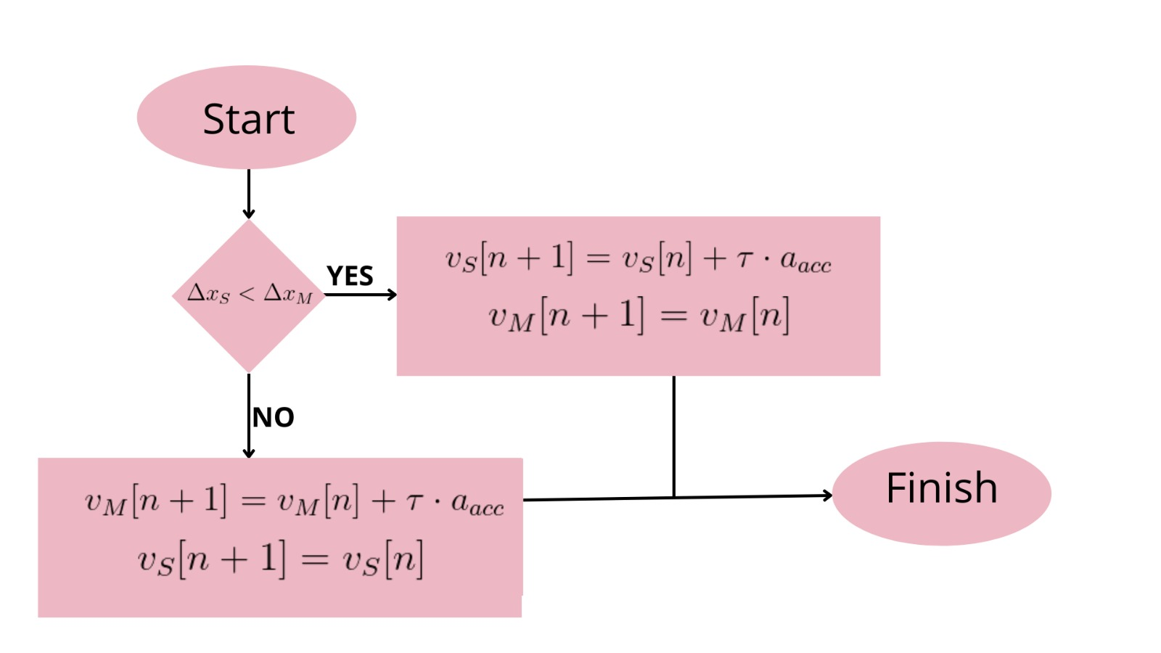
Merging control algorithm

Slide 7
IMPLEMENTATION

Slide 8
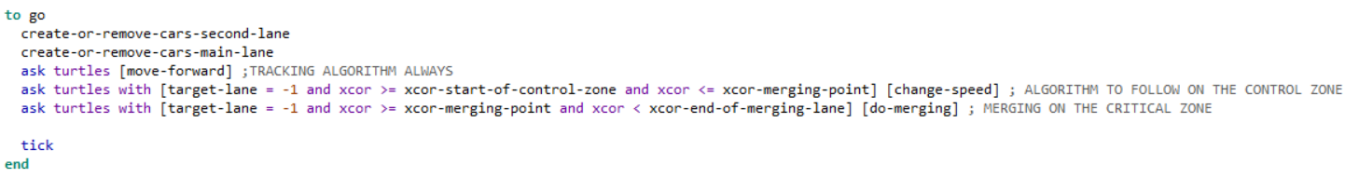
Implementation

Slide 9
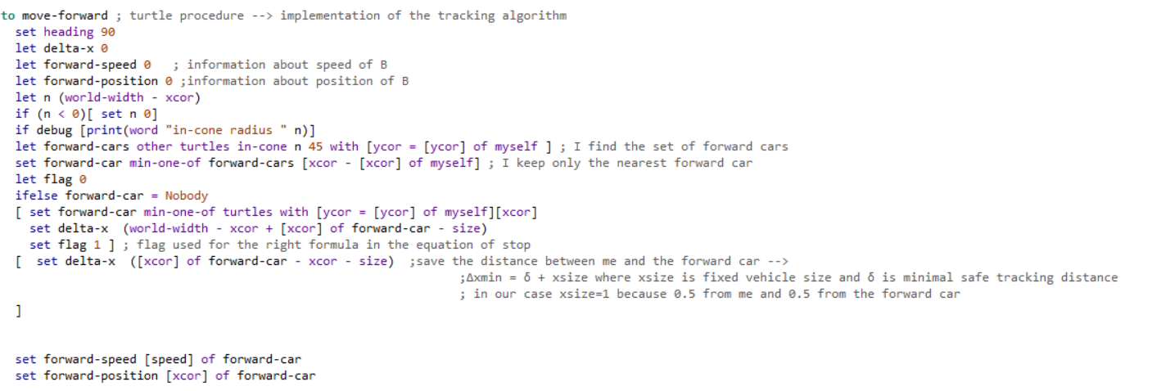
Vehicle tracking algorithm Implementation (1)
All cars have to find their forward car in order to adjust their speed accordingly.
Procedure to find the forward car:

Slide 10
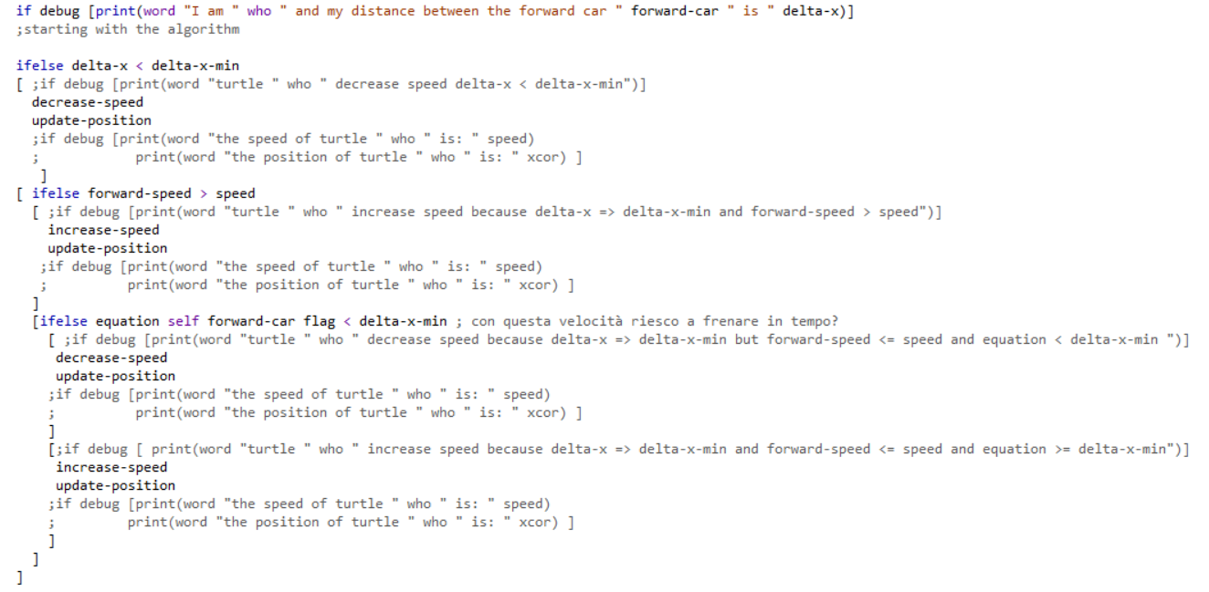


Vehicle tracking algorithm Implementation (2)

Slide 11



Vehicle tracking algorithm Implementation (4)

Slide 12
Vehicle tracking algorithm Implementation (2)

Slide 13
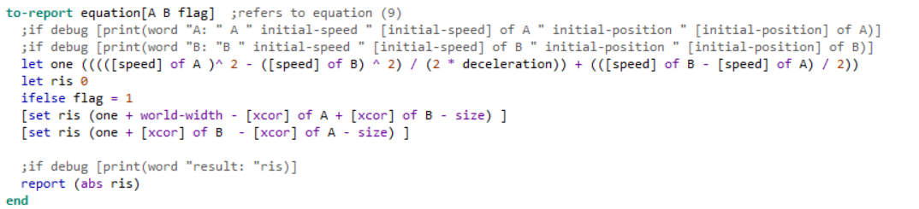
Vehicle tracking algorithm Implementation (3)

Slide 14

Merging control algorithm Implementation (1)
Change in the algorithm to avoid speed saturation:

Slide 15
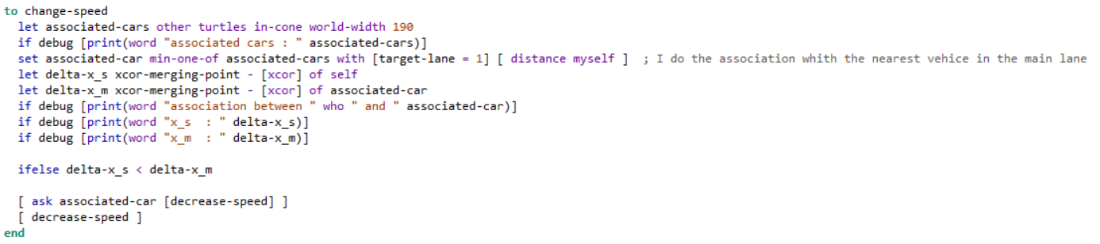
Merging control algorithm Implementation (2)
Procedure to find the associated car in the main lane

Slide 16
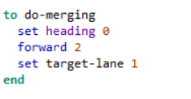
Merging control algorithm Implementation (3)
Nel merging point

Slide 17

SIMULATION

Slide 18

Scrivi tutti i parametri che valori hanno
Acc
Dec
….

